Slide 1

Open Source at Enterprise Scale
Jeremy Justus, Ross Sbriscia
Optum Technology
Notes:
There is no Open Source without a Community.

Slide 2
Jeremy Justus Sr Software Engineer
Expert Googler Kong Champion
Ross Sbriscia Sr Software Engineer
Expert Googler Kong Champion
Notes:
Need new pictures!

Slide 3
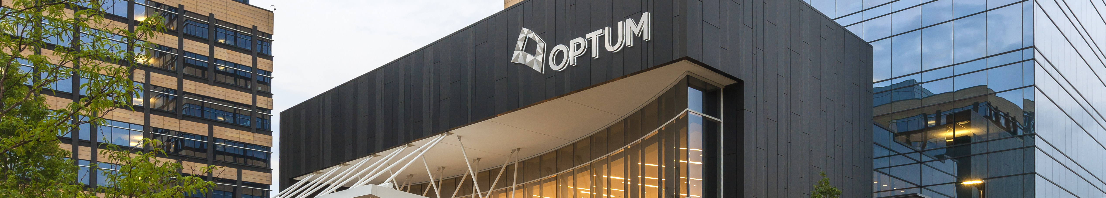
Healthcare Space 300,000 Employees Thousands of APIs Fortune Six Company
Optum Technology
Optum provides the tech infrastructure for UnitedHealth Group
Notes:
OPTUM LEGAL – PHOTO SOURCE: https://www.unitedhealthgroup.com/newsroom/media-library.html
Make a joke about not being Fortune 5 anymore?

Slide 4
Optum’s Gateway Solution, Late 2017
Vendor Product Gateway
Primary UHG Gateway solution since 2014
Stability Issues
Scalability Issues
Poor Performance
Low Supportability
High Operating Costs

Slide 5
Optum’s Modernization Movement
Invest in Open Source!
An organizational change in mindset, as both a top-down and bottom-up initiative.
Supported By
Engineers
Architects
Legal
Security
Sr. Executives
Notes:
OPTUM LEGAL – PHOTO SOURCE: https://library.optum.com/media-assets-library/asset-view.5c808afa-cce4-49c2-a5c8-d4d809bfc19f.html
Clear and Easy path to Open-Source Contributions
Open-Source Development Practices
Due to these factors,
Top-Down & Bottom-Up movement
Legal, EIS, Sr Exec, Engineers, Architects

Slide 6
Gateway Selection Criteria
Open Source vs Proprietary
Avoid vendor lock
Licensing management/cost
Extensibility
Stateless vs Stateful
Ease of scale and replication
Automated build and deployments
Decreased recovery time
Federated DevOps model
Performance
Asynchronous routing
Resource efficiency
Higher throughput
IMAGE
PLACEHOLDER

Slide 7
Organizational Boilerplate
0
Path to a Kong PoC

Slide 8
Legal & Security
Improved Routing
Negotiated a security policy change to eliminate two gateway-hop routing flow
IMAGE
PLACEHOLDER
Security Requirements
Supplemented Kong with a WAF solution to meet internal security standards for the API GW layer
Open Source Approval
Due to efforts made during the modernization movement, this was easy!
Notes:
Entire slide is basically a placeholder. Only the content is correct, but formatting will change
Will likely be 2 slides with some good visuals when it’s all said & done.

Slide 9
Supporting Open Source
“How can we, as a large enterprise, have confidence in Open Source products?”
Notes:
When we announced that we had chosen to vet Kong, as our first candidate technology, we had a lot of questions from within the Company about supportability
What would we do in an emergency?
What would we do if a release didn’t work?
Effectively – “title” – . Today, we’re going to try and answer that question from our own experience.

Slide 10
Cultivate Internal Experts
1
Take the expertise from the Open Source community, and make it work for you
Notes:
[ spiel ] – Understand this model not only matches the vendor-provided model, but significantly 1-ups it. To see why, let’s quickly look at the vendor-model

Slide 11
Vendor-Provided Model
Experts are “rented”, and expertise is rendered only on specific requests
- Experts can only react, not innovate
Experts are unfamiliar with the specific environmental conditions
- Can significantly increase time to restoration, and reduce overall efficacy during troubleshooting
Product is opaque, and your team’s understanding of it is limited
- Severely hampers internal innovation around the solution
Notes:
Make sure

Slide 12
Open-Source Model
Experts have the opportunity to leverage their skills for the benefit your entire space
- Experts can optimize integrations, support and ops because of this understanding
Experts are fully versed in the specific environmental conditions
- Can significantly decrease MTT, and maximize overall efficacy during troubleshooting
Product is entirely visible, and your team’s understanding of it is fully unhindered
- Enables cultivated experts to do full fledged solutioning
Notes:
OPTUM LEGAL: Photo Source - https://hub.uhg.com/sites/hub/Resources/Brand/UnitedHealth-Group-Brand/ImagesBusiness/Forms/DispForm.aspx?ID=29&Source=https%3A%2F%2Fhub%2Euhg%2Ecom%2Fsites%2Fhub%2FResources%2FBrand%2FUnitedHealth%2DGroup%2DBrand%2FImagesBusiness%2FForms%2FThumbnails%2Easpx&ContentTypeId=0x01010200D08BDA4379D60F46BD30D259A66B22C6
Clear and Easy path to Open-Source Contributions
Open-Source Development Practices
Due to these factors,
Top-Down & Bottom-Up movement
Legal, EIS, Sr Exec, Engineers, Architects

Slide 13
How do we cultivate Internal experts?
Notes:
Which brings me to our second idea -

Slide 14
Community Participation
2
Tried but True
Notes:
This gets thrown around so often it’s understandable to consider it in the same vein as somany overused memes, but truely embracing this idea is absolutely necessary to benefit from the virtuous cycle of open-source. There’s no 50/50 here. To do Open Source right, you need to jump in head first.

Slide 15

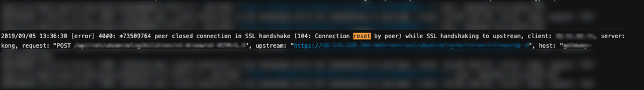
Head-First
Customer Reported HTTP 502s returned from their Proxy
HTTP Log Plugin logging no events for those transactions
Kong STDOUT Logging ’Connection Reset’ by Upstream
Notes:
To answer that question, let’s skip forward to early 2018 and take a look at the first time Optum interacted with Kong (FIX WORDING)

Slide 16
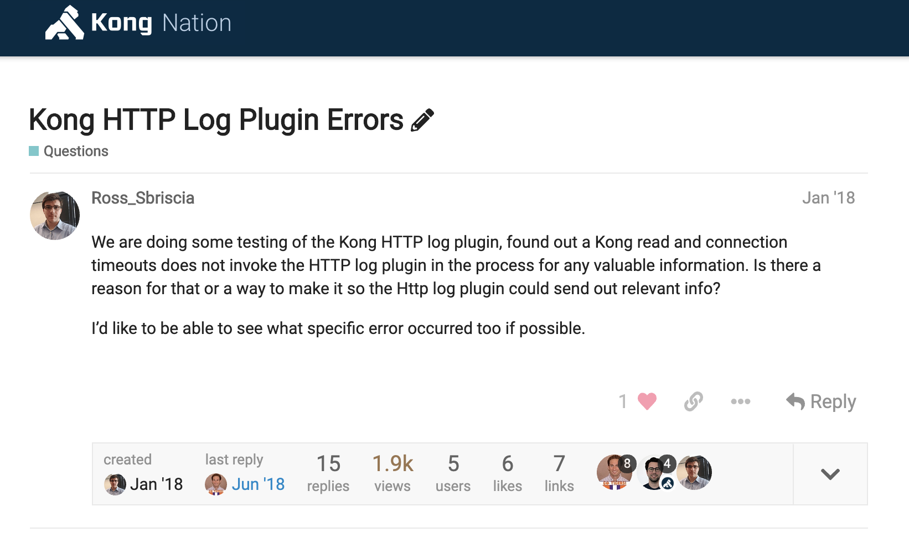

Slide 17
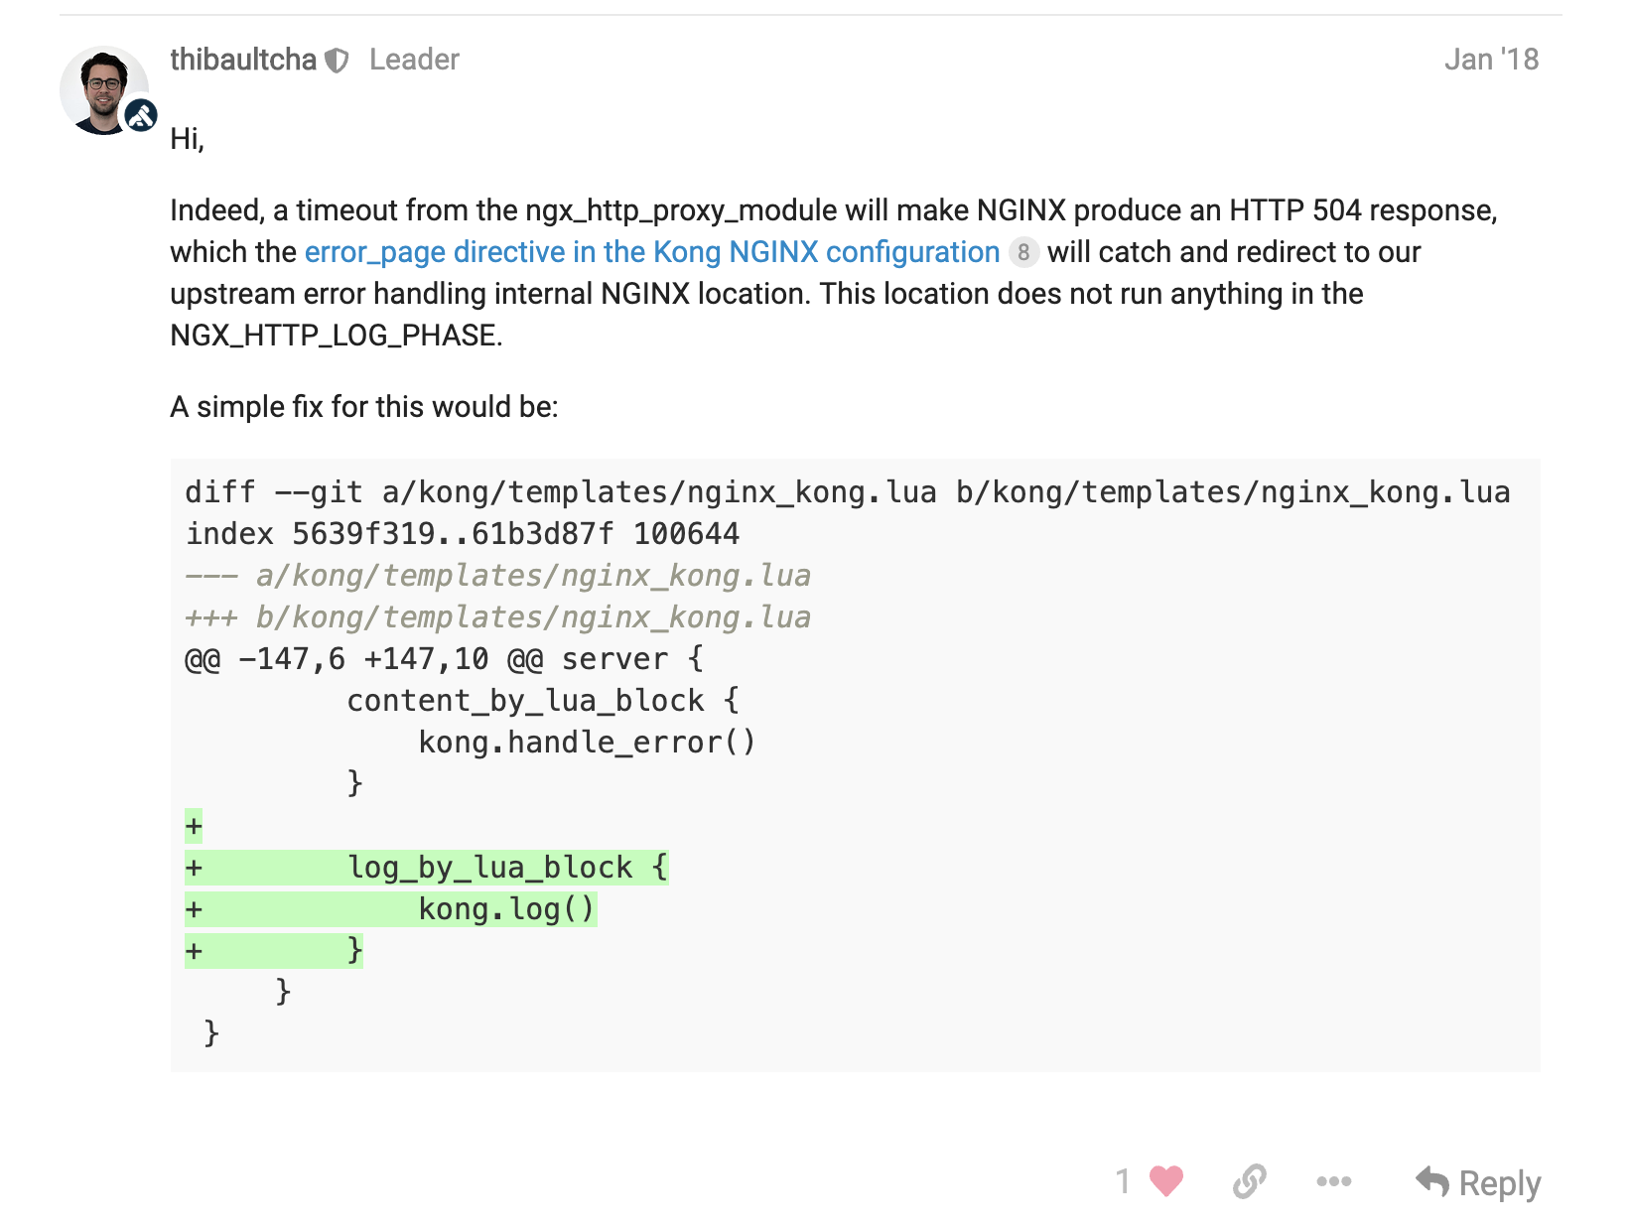

Slide 18
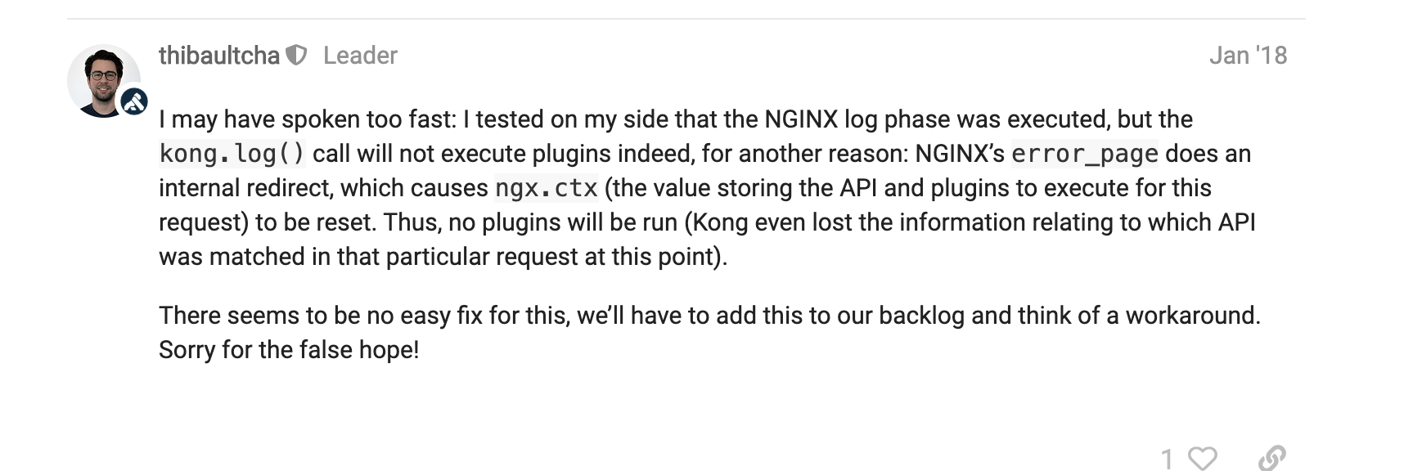

Slide 19
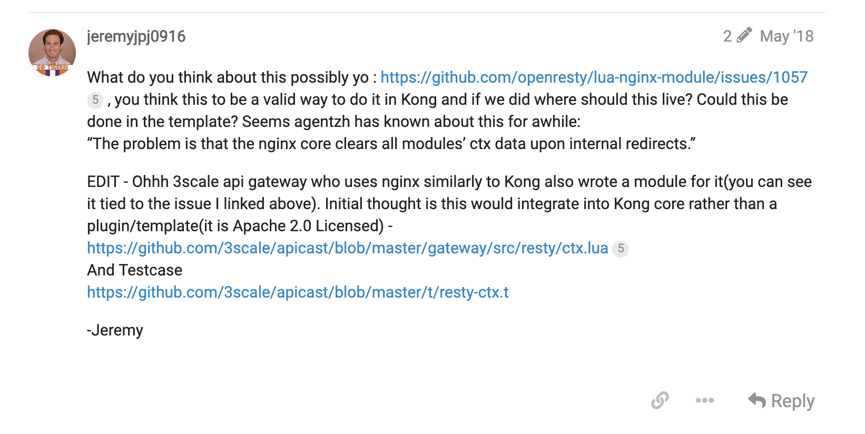

Slide 20
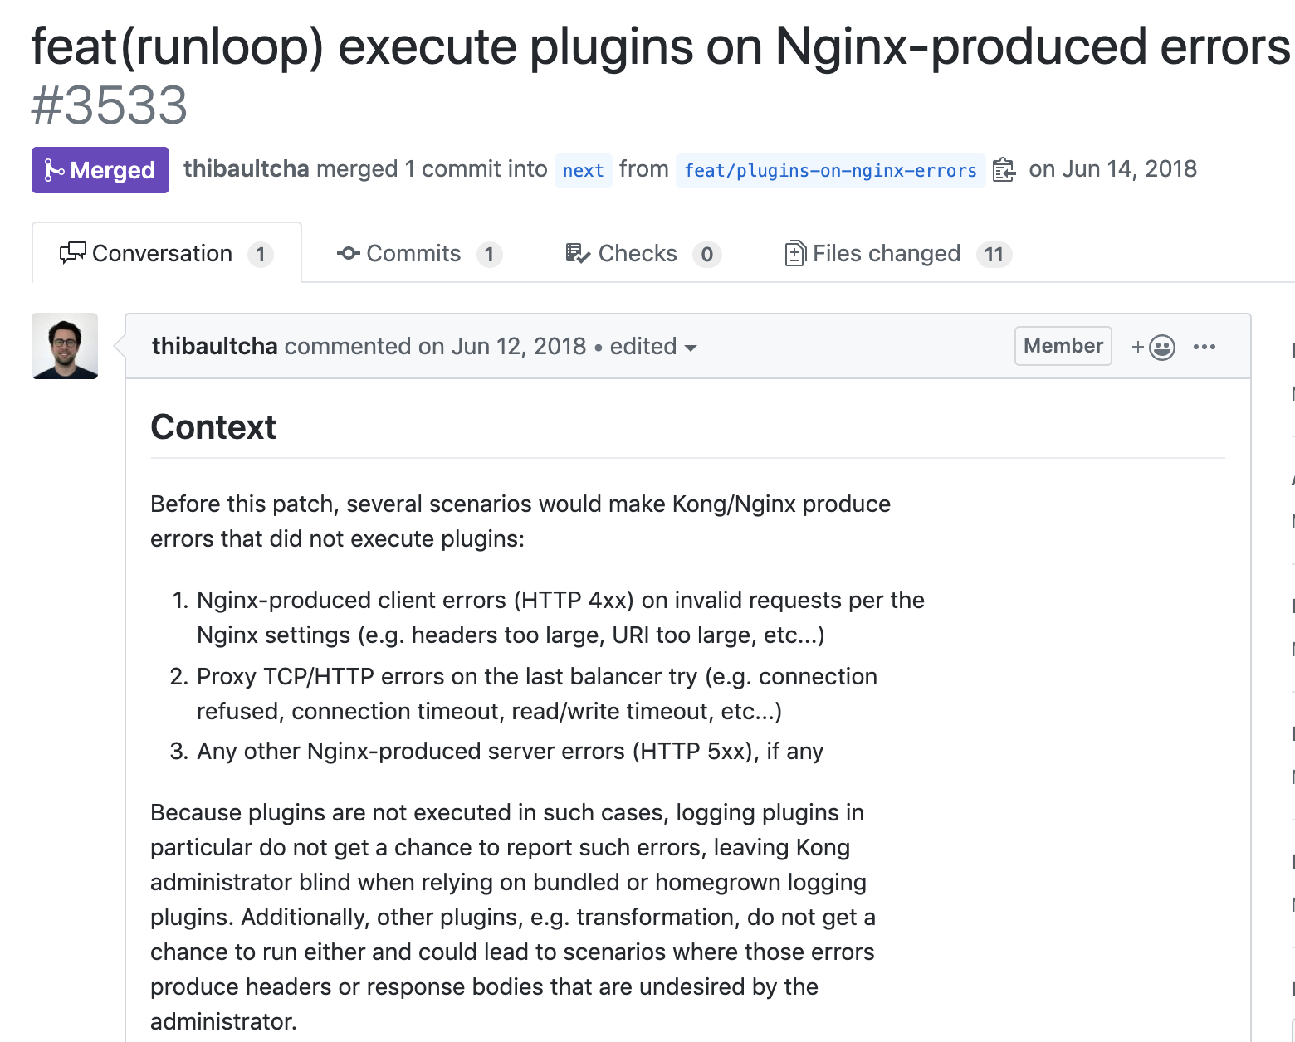

Slide 21
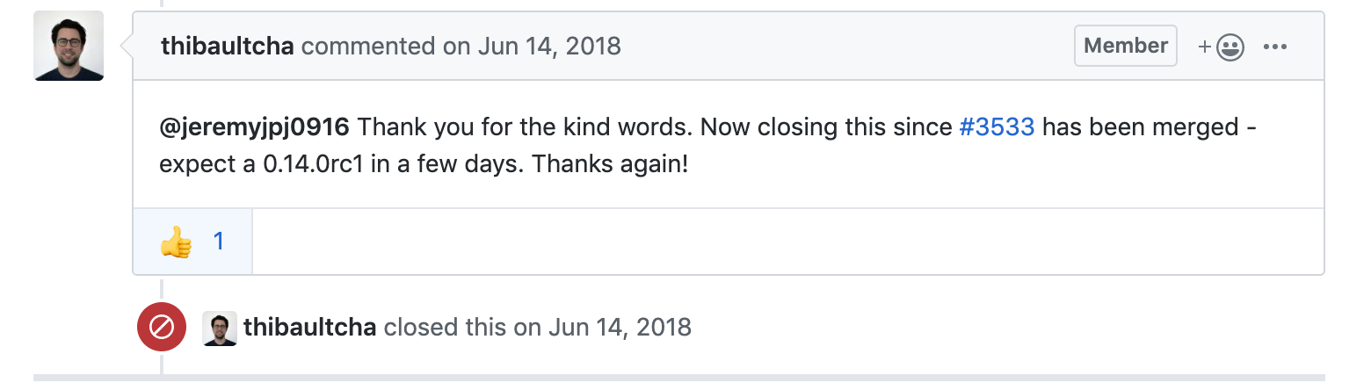
Notes:
To answer that question, let’s skip forward to early 2018 and take a look at the first time Optum interacted with Kong (FIX WORDING)

Slide 22
The Beginnings of Expertise
We had a problem
We investigated it
Issue came back to Kong
We engaged the community
We tried a possible solution from the community
No dice :P
We investigated it
We suggested a possible solution to the community
The community confirmed the solution
Notes:
So let’s recap what happened here
[speil]

Slide 23
The Beginnings of Expertise
We had a problem
We investigated it
Issue came back to Kong
We engaged the community
We tried a possible solution from the community
No dice :P
We investigated it
We suggested a possible solution to the community
The community confirmed the solution
Notes:
Now, there’s something a little weird here. This step appears twice.
So what changed between the first time we investigated the problem, and the second time we investigated the problem?
What changed was the problem, from our perspective. It went from “there’s something wrong with logging transport-layer errors in Kong” to “The problem is that the nginx core clears all modules’ ctx data upon internal redirects”.
Notice this fundamental difference between this interaction, and one with a vendor-provided expert.
This is a two way street – with knowledge flowing in both directions.
This is the virtuous cycle of open-source

Slide 24
Contributing Back
3
Embracing the virtuous cycle of Open Source

Slide 25
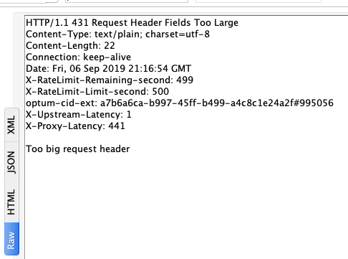
QA to
Code Contributor
Kong Flexibility
Notes:
To answer that question, let’s skip forward to early 2018 and take a look at the first time Optum interacted with Kong (FIX WORDING)

Slide 26
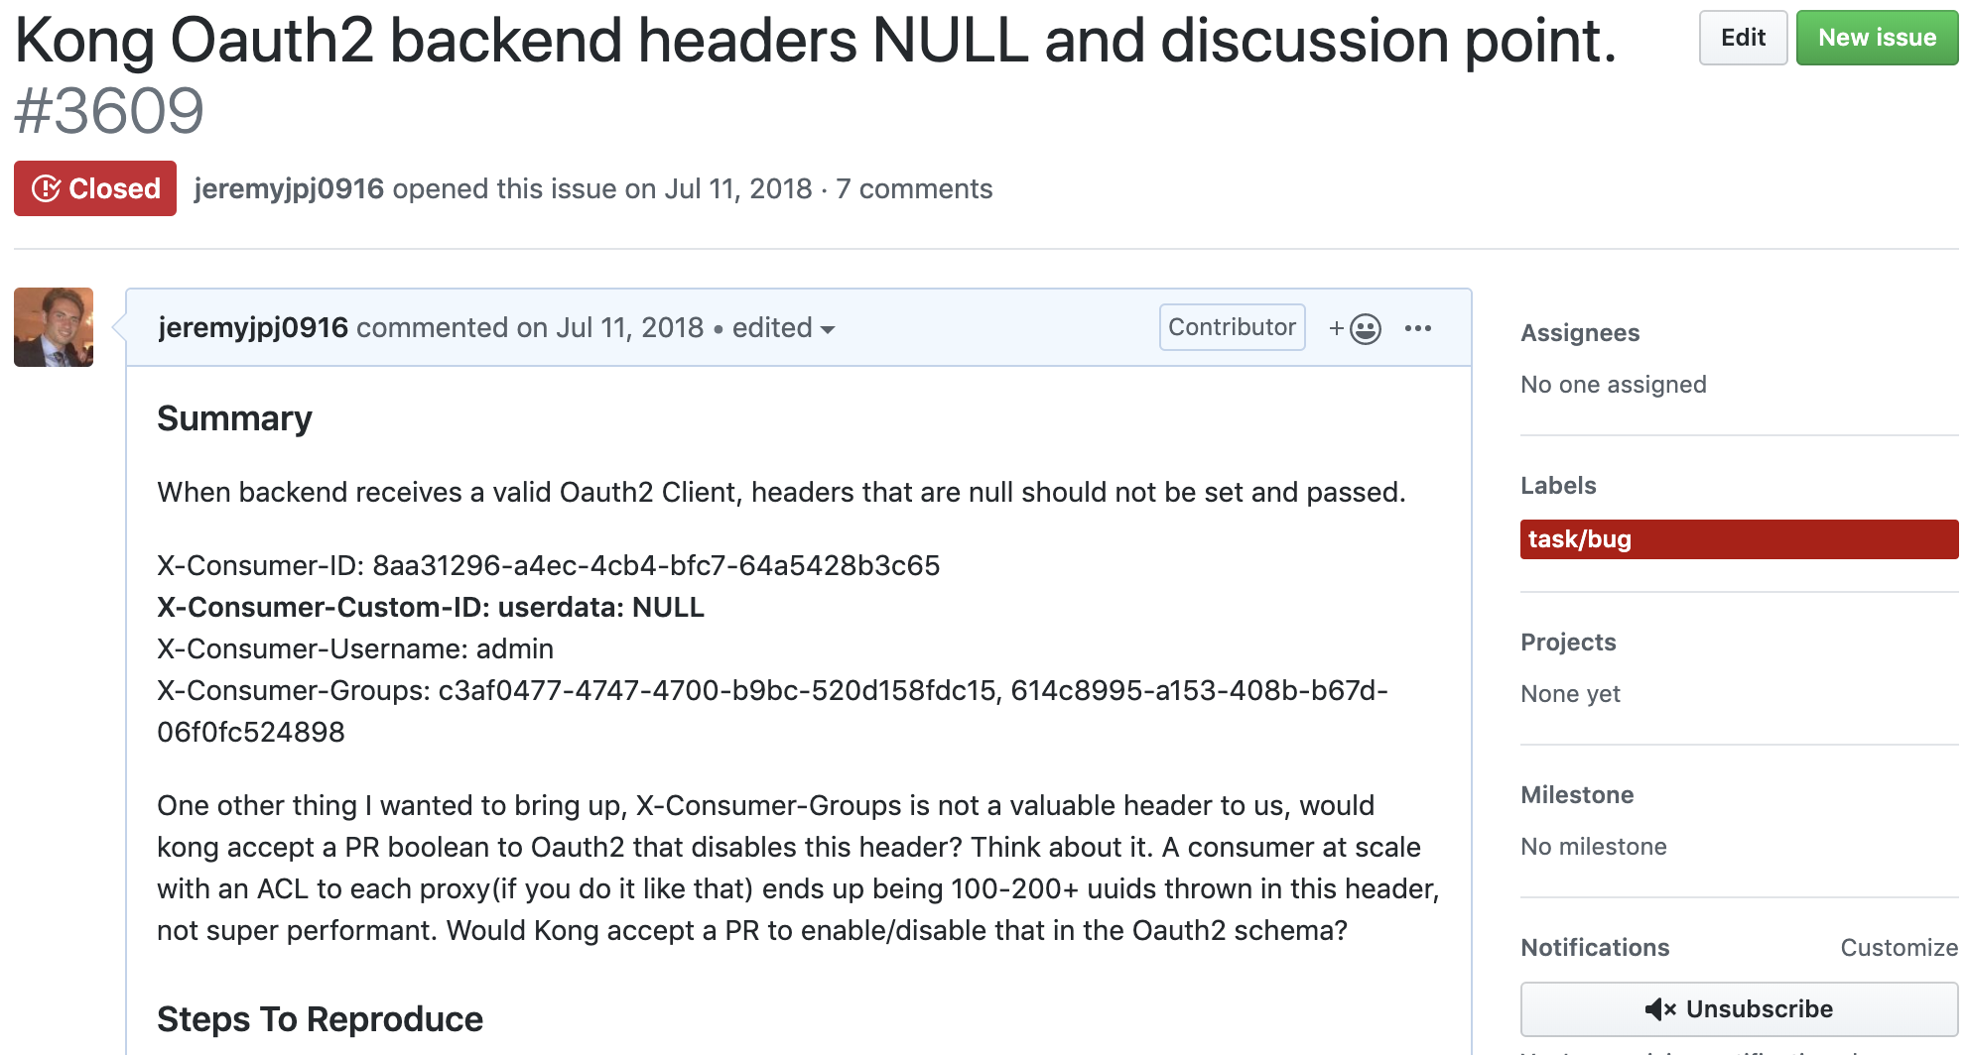
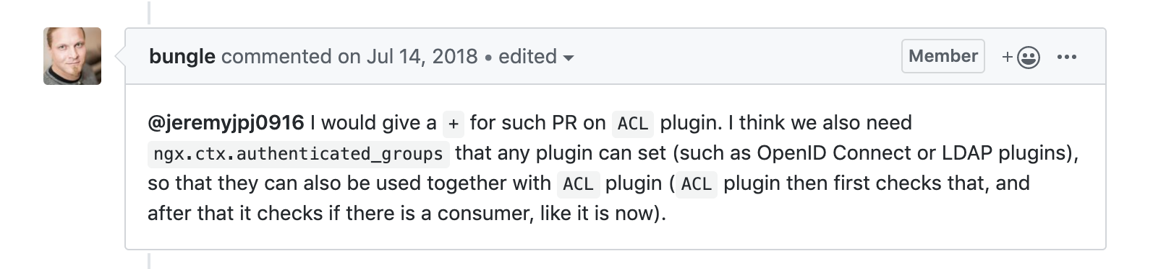
Notes:
To answer that question, let’s skip forward to early 2018 and take a look at the first time Optum interacted with Kong (FIX WORDING)

Slide 27
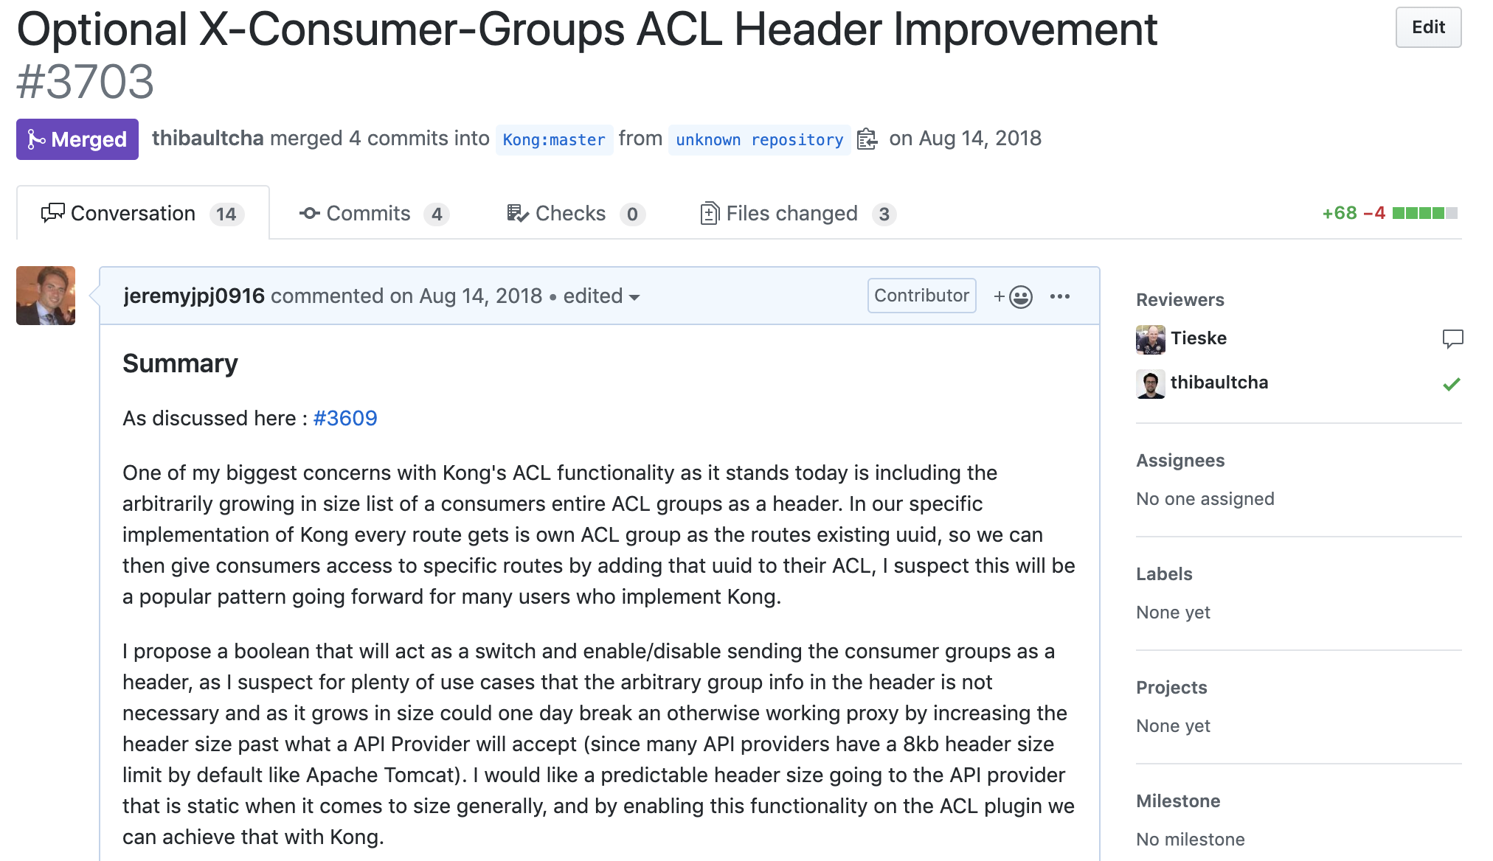
Notes:
To answer that question, let’s skip forward to early 2018 and take a look at the first time Optum interacted with Kong (FIX WORDING)

Slide 28
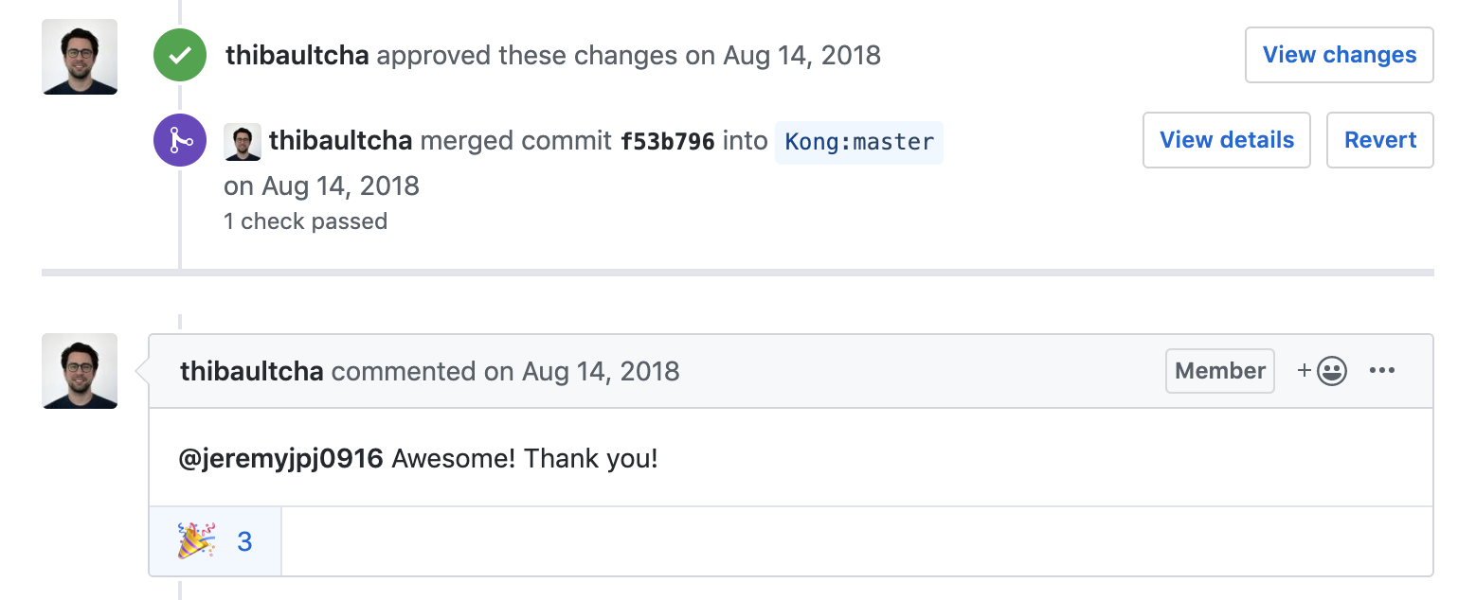
Community is Kong’s DNA
Notes:
To answer that question, let’s skip forward to early 2018 and take a look at the first time Optum interacted with Kong (FIX WORDING)

Slide 29
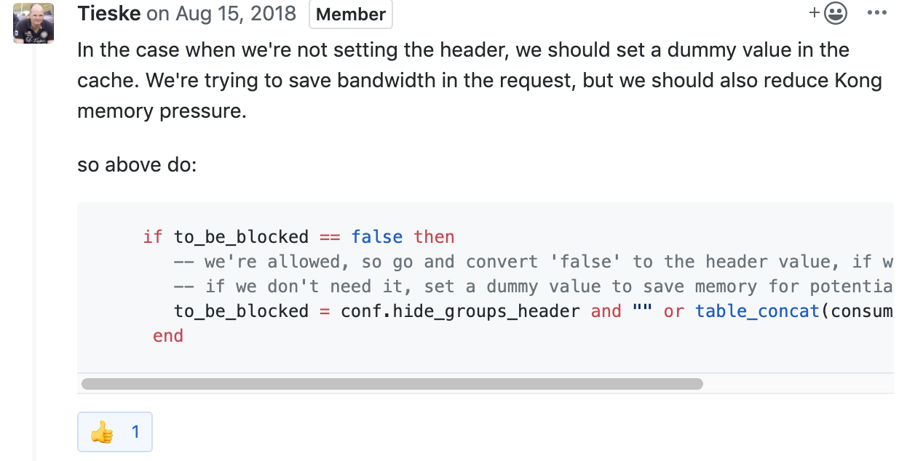
Open Collaboration and Iteration
Notes:
To answer that question, let’s skip forward to early 2018 and take a look at the first time Optum interacted with Kong (FIX WORDING)

Slide 30
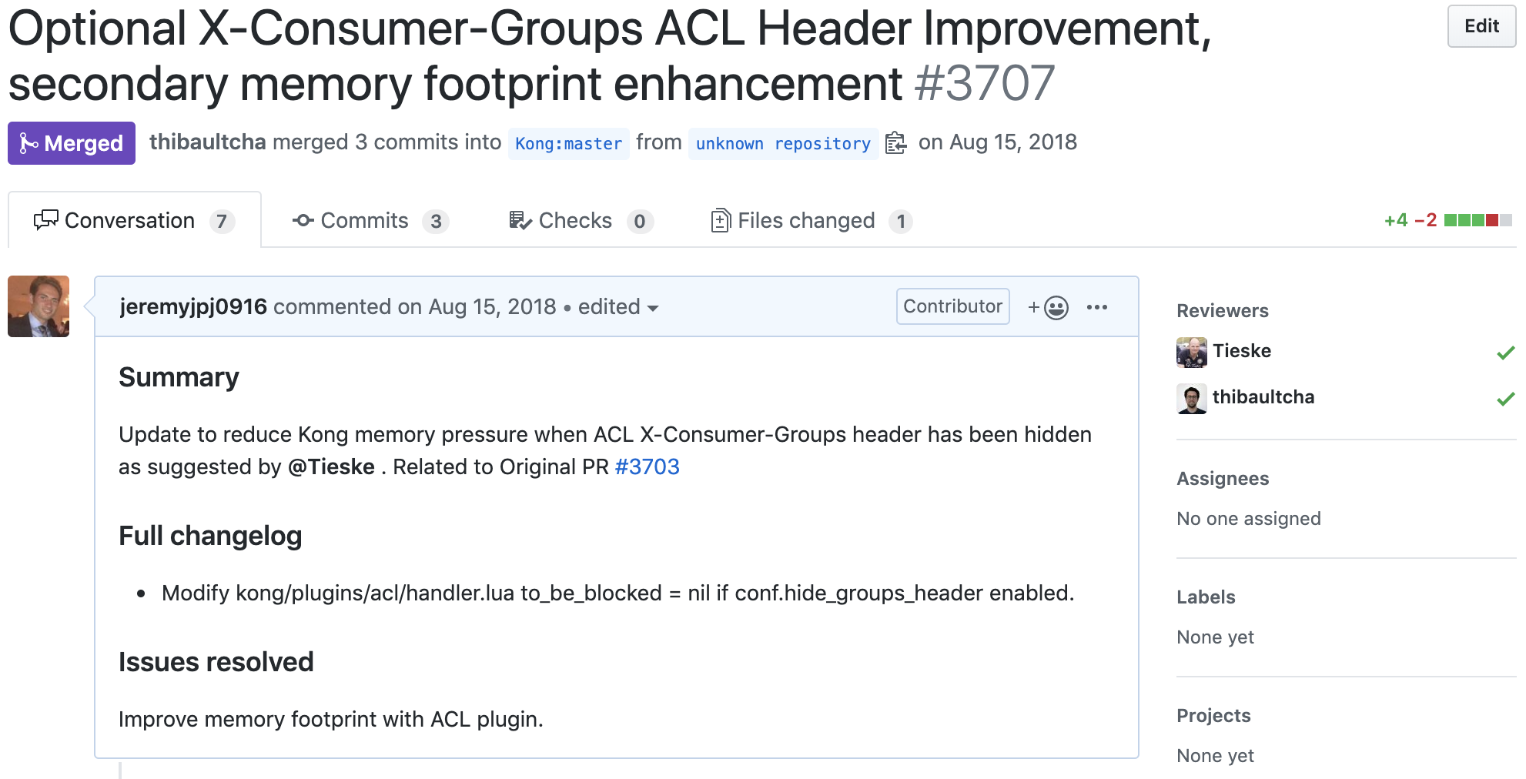
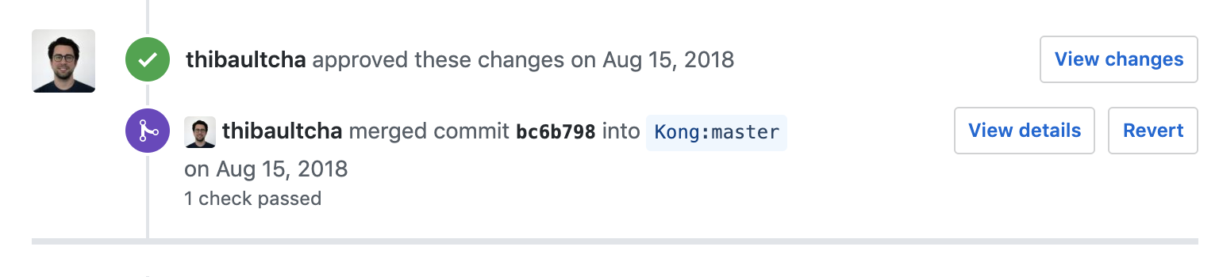
2 PRs Merged on Same Day Delivered?
They said it couldn’t be done..
Notes:
To answer that question, let’s skip forward to early 2018 and take a look at the first time Optum interacted with Kong (FIX WORDING)

Slide 31
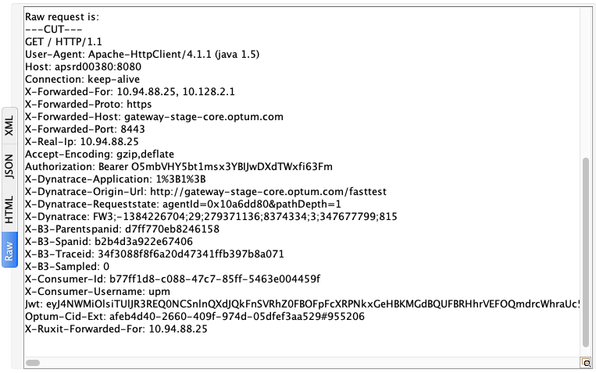
End Result?
Better Kong
+
Happy
Backend
API
Notes:
To answer that question, let’s skip forward to early 2018 and take a look at the first time Optum interacted with Kong (FIX WORDING)

Slide 32
Offer a Product
4
Think of the technology and its integrations as a complete product

Slide 33
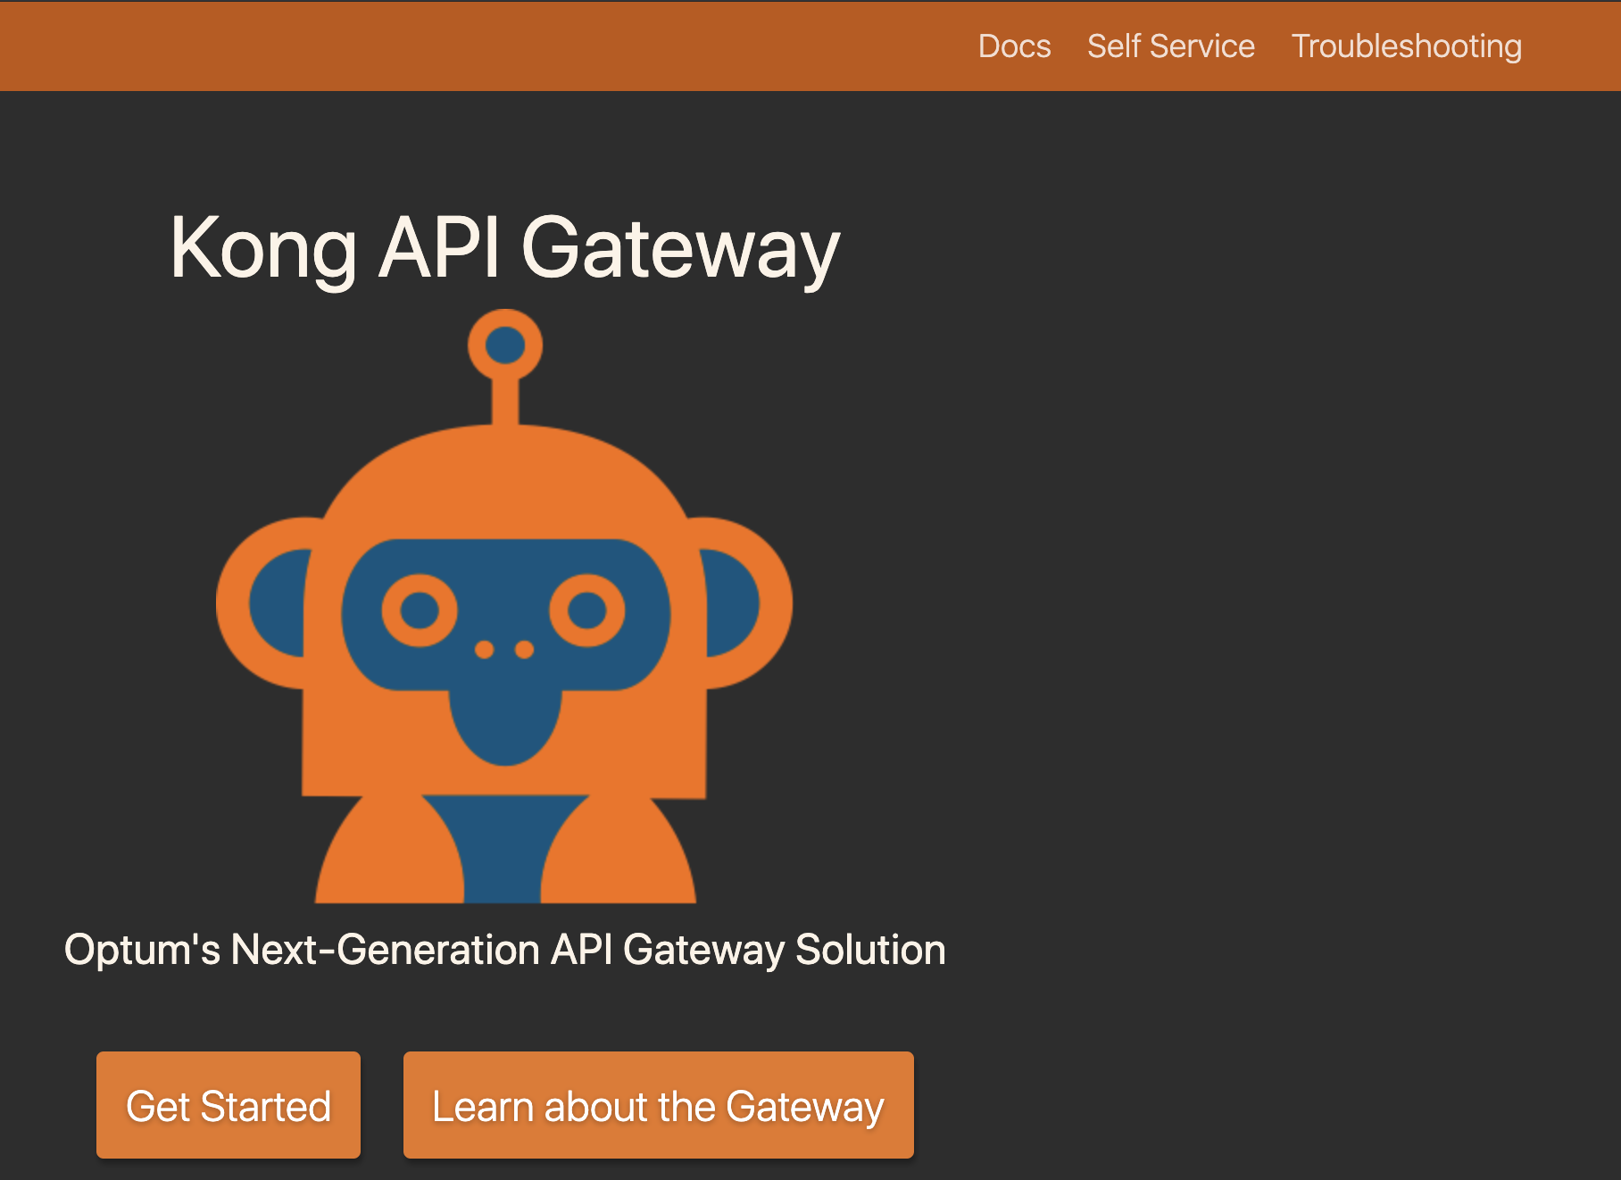
Docs First Approach
Lowers Operational Staffing Needs
Good documentation drastically reduces the need to meet & plan integrations, thus reducing the need for a large support team.
Good Engineering Culture
Providing environment-specific documentation provides your customers with the opportunity to innovate around your product, and enables DevOps!
Optum’s docs site contains 34 pages, covering everything
from supported security patterns, to self-service instructions.
Yes, we did give it an internal mascot ☺

Slide 34
Operations Modernization
Email distribution list dialogs
Ticket work orders
Self-Service
-Github ops model
-Customer PRs to repo
-Github Webhook calls to Agent
-Agent integrates with Kong Admin API
IMAGE
PLACEHOLDER
Notes:
Make sure

Slide 35
Kong Resource Abstractions
Requirements
Namespace
Service level owner email
Team distribution list email
Access Control
Internal ID
Components
Namespace resource
Proxy resource
{
"kind” : "gateway-namespace",
"action” : "create",
"spec” : {
"id” : "xxxxxxxx-xxxx-xxxx-xxxx-xxxxxxxxxxxx",
"namespace” : "kong.summit.consumer",
"sloEmail” : "my.email@example.com",
"teamEmailDL” : "my.team.dl@example.com",
"accessControl” : "REDACTED",
"internalID” : "REDACTED"
},
"metadata” : {
"tags” : [
"Kong Summit 2019",
"Example Tag"
]
}
}
Notes:
To answer that question, let’s skip forward to early 2018 and take a look at the first time Optum interacted with Kong (FIX WORDING)

Slide 36
Self-Service Ops Flow
Customer reads docs
Customer PRs to Github
Self-Service Bot Processes PRs
Bot Feedback to Customers on PRs
Customer PRs adjustments if necessary
Feedback Loop
Github Webhook
Call to Kong Admin API
Notes:
To answer that question, let’s skip forward to early 2018 and take a look at the first time Optum interacted with Kong (FIX WORDING)

Slide 37
Results
5
Progress of our Ongoing Journey

Slide 38
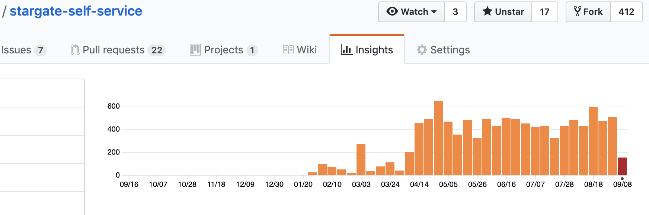
Dev Ops Self-Service Adoption
Notes:
To answer that question, let’s skip forward to early 2018 and take a look at the first time Optum interacted with Kong (FIX WORDING)

Slide 39
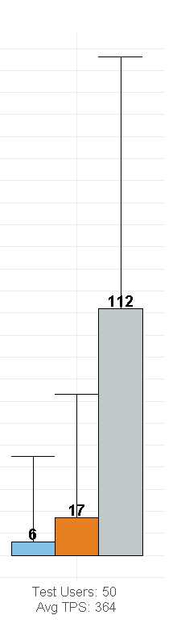
Comprehensive Improvements
>80% Reduction in Gateway Overhead compared with existing solution
>95% cost reduction (operational efficiency, licensing costs)
>85% reduction in operations staffing
2 Engineers supporting 300k Employees
Currently serving ~10% of all UHG API Traffic
Extensibility of Kong has provided the means to support many custom use cases within Optum
Kong’s superior performance
Notes:
To answer that question, let’s skip forward to early 2018 and take a look at the first time Optum interacted with Kong (FIX WORDING)

Slide 40
The Question
“How can we, as a large enterprise, have confidence in Open Source products?”
Notes:
Let’s return to our original question [say subtitle], and see if; based on these and other experiences, we can come up with an answer.

Slide 41
Our Answer
Cultivate Internal Experts
Engage with the Community
Contribute Back
Offer a Product
DevOps Enablement
Good Docs
Higher Quality Integrations

Slide 42

Notes:
There is no Open Source without a Community.

